Slide 1
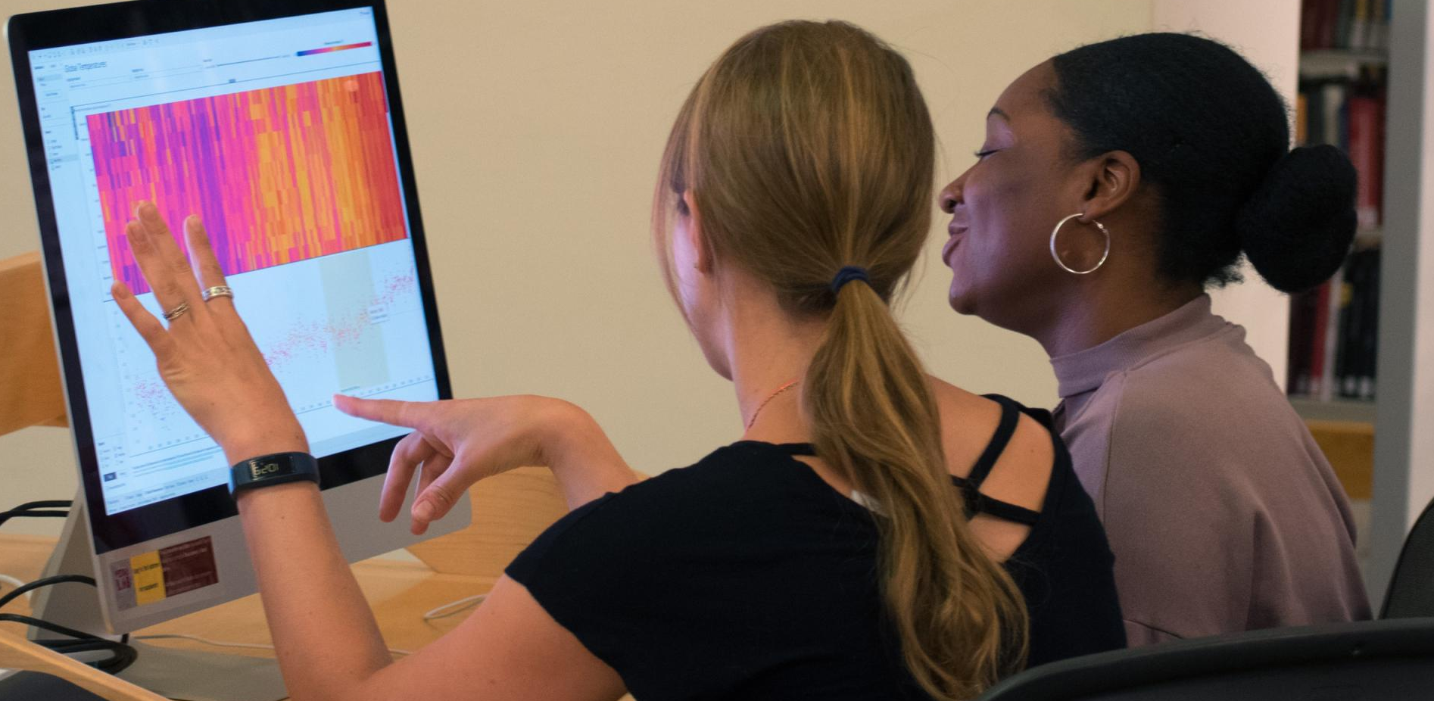
Making Peer Learning Accessible: Tools and Practices
September 27, 2019
Notes:
Thanks for coming!
Session is aimed at the crossroad of 3 topics:
Amy Deschenes (pronounced “deshayn”) – accessibility
Kerry Foley – peer learning
Gabe Abrams – tools
In the spirit of peer learning, I learned a LOT from these two. Together

Slide 2
Agenda & goals
Slides, Handout, Activity: bit.ly/hilt-a11y-resources
Intro + Overview:
Accessibility
Teaching Practices
Tools
Practices & Tools Applied to Examples
Example 1: Turn to your Neighbor
Example 2: Semester-long Group Project
Activity
Notes:
Gabe:
Remember to mention the link!
Hand off to Amy

Slide 3
Intro + Overview

Slide 4
Accessibility
Making content and experiences available to and usable by everyone, including and especially, people with disabilities.
Notes:
AMY

Slide 5
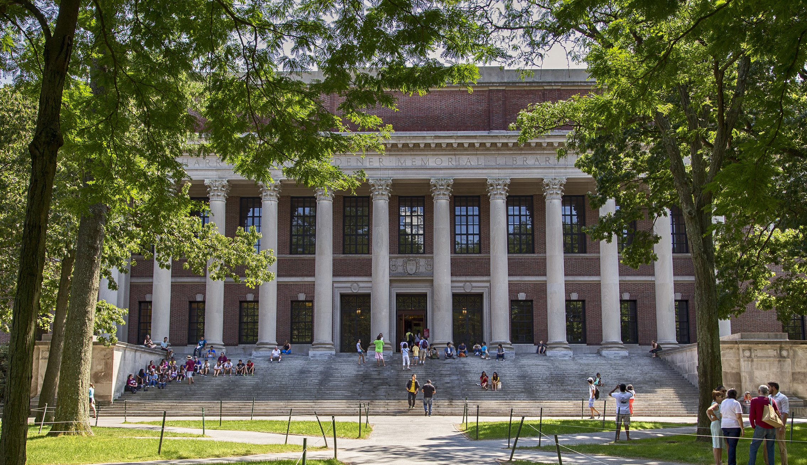
Notes:
AMY - I’m the Head of UX & Digital Accessibility at Harvard Library and oversee the User Research Center, Harvard’s only usability & digital accessibility testing lab. In my day to day, I conduct user research with non-disabled and disabled users of the library’s digital products like HOLLIS and our websites.

Slide 6
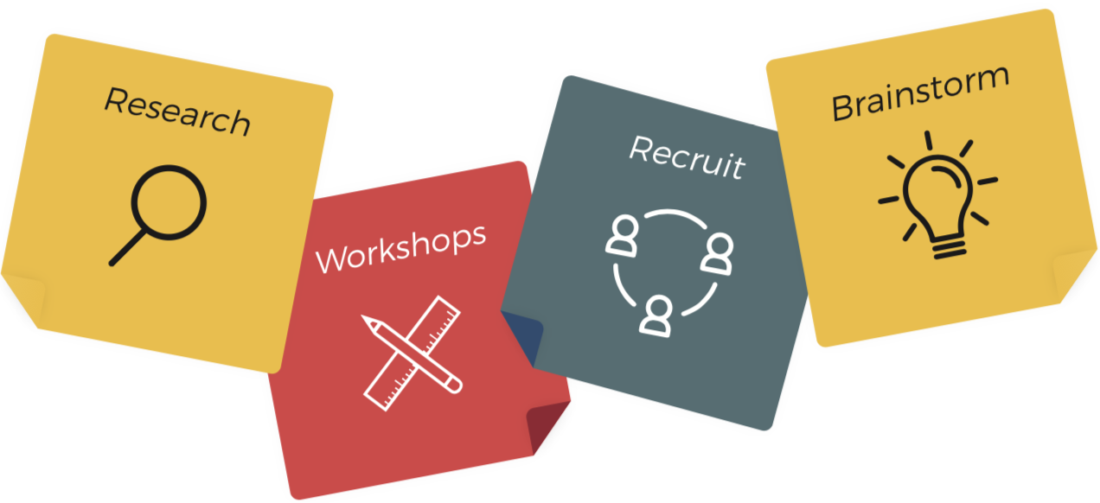
USER RESEARCH
CENTER
Learn more about user research
Harvard’s premier lab for user-centered design, digital accessibility, and testing.
Consult with experts on usability and digital accessibility
Recruit participants from the lab’s testing pools
Book our space for user testing or borrow equipment to run tests anywhere
Attend workshops & events
Lamont Library, Room A10 | urc.library.harvard.edu
libraryux@harvard.edu | @UserResearchCtr
Notes:
AMY As part of my role I oversee the User Research Center which is Harvard’s only usability and digital accessibility testing lab. We offer services like consultations, drop-in hours, as well as learning opportunities like brown bag lectures. The space and lendable equipment can be used for digital accessibility testing on any Harvard products.

Slide 7
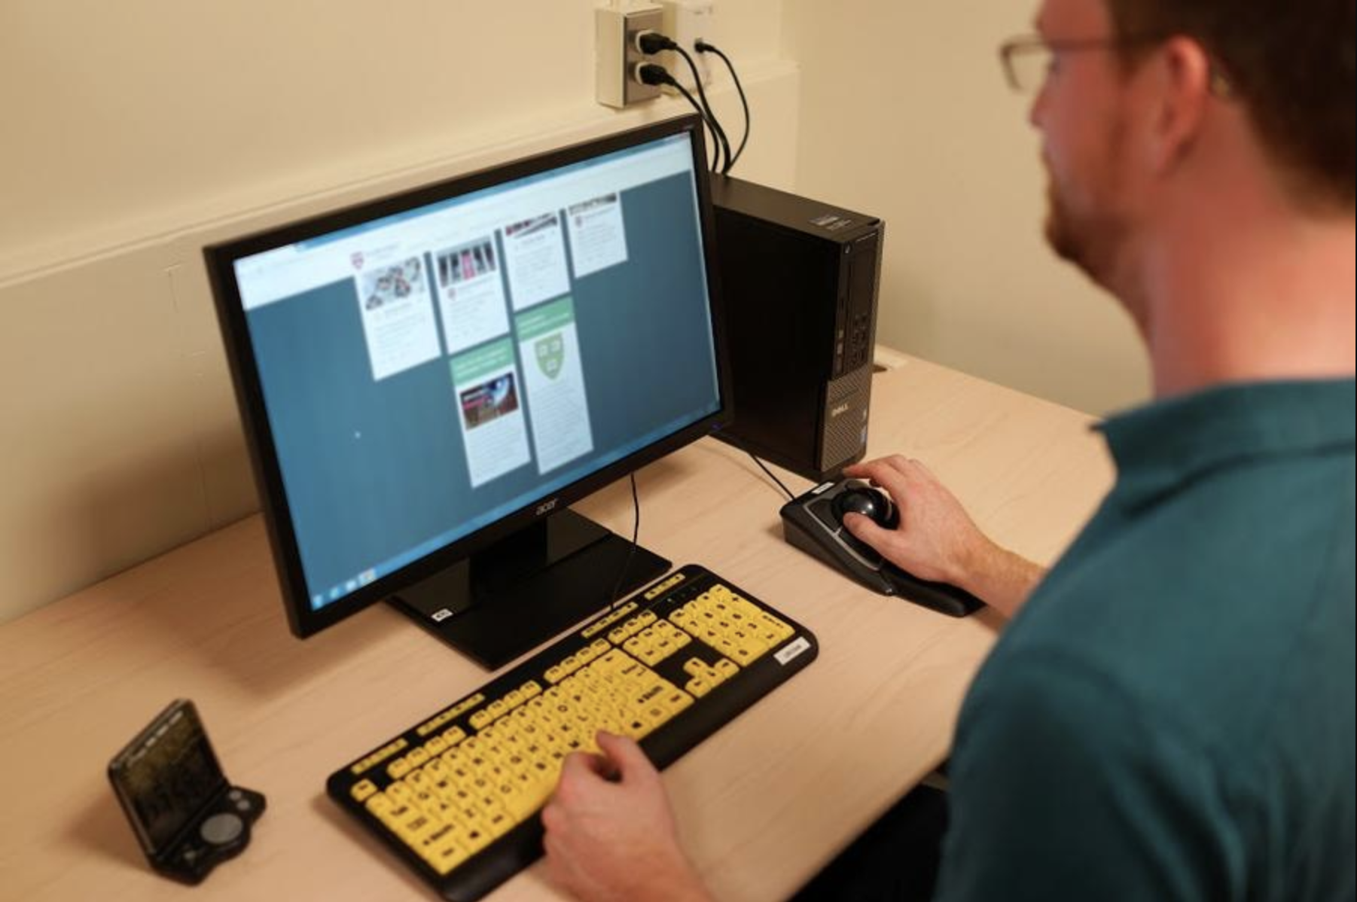
Notes:
AMY - At the User Research Center we offer accessibility reviews and the opportunity to include people with disabilities in user testing of digital products like websites, apps, and courses. I’ve been at Harvard for nearly 5 years and have heard about some of the accessibility-related barriers students experience. I want to share one of those stories with you today.

Slide 8
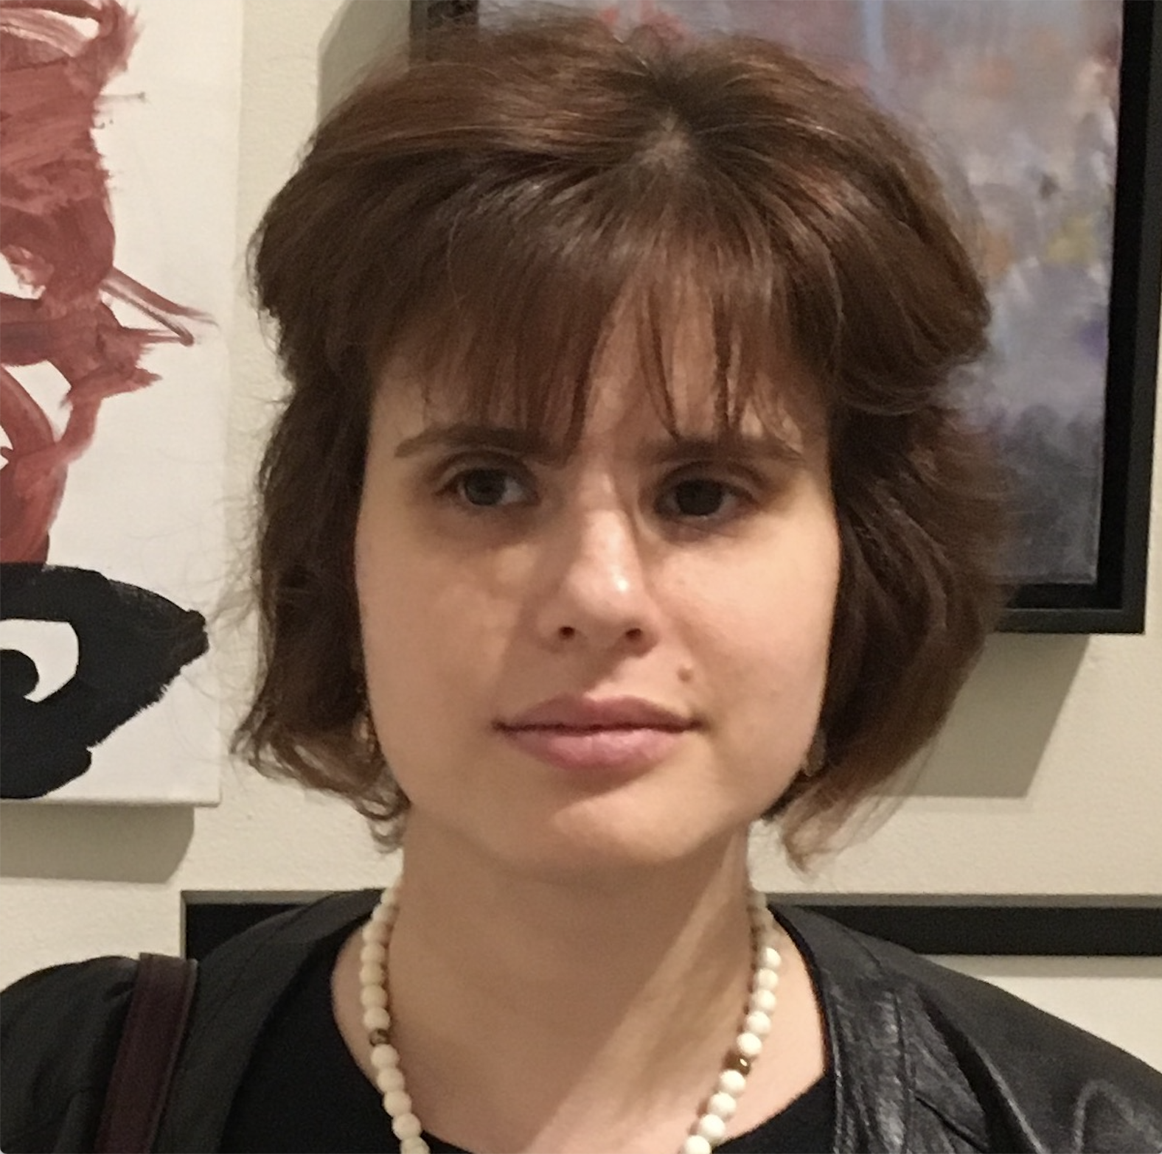
Notes:
AMY This is Tasha. She is an alum of GSE, class of 2015. She is blind and uses a screen reader to access course materials while in classes at Harvard. Before adopting Canvas, GSE used iSites for their course materials. Tasha told me that it worked well, except that the place where the grades and comments were posted was not accessible by keyboard. She had made her professors aware of this, but sometimes they would forget. So even after Tasha’s classmates knew the outcome of their hard work, Tasha was left wondering and distressed with no grades and no feedback on her papers.

Slide 9
“I had to ask a friend to check my grade and read me the comments - which is not an ideal situation.”
Tasha, GSE alum
Notes:
AMY She had to ask a friend to check her grade and read the comments, which she described as not an ideal situation, which puts it mildly! Clearly, this put Tasha in an inequitable position of having to ask a fellow student to read her the professor’s comments and tell her the final grades. The private communication that students expect to have with their professors was not available to Tasha simply because the technology had not been thoughtfully vetted for accessibility.
This is only one experience, but I think it’s helpful to keep accessibility people focused as much as possible, rather than standards-focused.

Slide 10
19%
of the U.S. population has a disability
Notes:
AMY
To put things in a larger perspective, according to the U.S. census bureau. It’s important to remember that disabilities can be temporary. These disabilities fall under four broad categories: visual, hearing, cognitive, and mobility.
.

Slide 11
Disabilities overview
Vision
Cognitive
Hearing
Mobility
Notes:
AMY
Visual (blindness, low-vision, color blindness)
Hearing (deafness, hard of hearing)
Motor (inability to use mouse, limited fine motor control)
Cognitive (learning disabilities, inability to focus)
Some people with disabilities use assistive technology, aka “AT”

Slide 12
Assistive technology
Vision (screen readers, magnification software)
Hearing (transcripts, captioning, hearing aids)
Cognitive (browser extensions for reading, color overlays)
Mobility (alternative input devices, eye-tracking control)
Notes:
AMY
Screen Readers
JAWS (industry standard)
NVDA
VoiceOver (Mac & iOS)
ChromeVox
Screen Magnifiers (ex. ZoomText)
High Contrast Keyboard
Refreshable Braille Display

Slide 13
Harvard’s Digital Accessibility Policy
Adopted April 30, 2019
New digital content created and produced at Harvard after December 1, 2019 must adhere to WCAG 2.1 standard.
Also applies to code for redesigned websites.
Notes:
AMY Harvard has released a Digital Accessibility policy that states new and redesigned content after 12/1/2019 must comply with the WCAG 2.1 standard. WCAG standard is the accepted standard for making websites accessible and is managed by the W3C (www consortium). More information about the policy is forthcoming and HUIT is hiring staff members to support the requirements.
While policies and standards are helpful when thinking about accessibility, what’s most important is to keep your considerations people-focused. I’d like to share a quote from another Harvard student who is dyslexic.

Slide 14
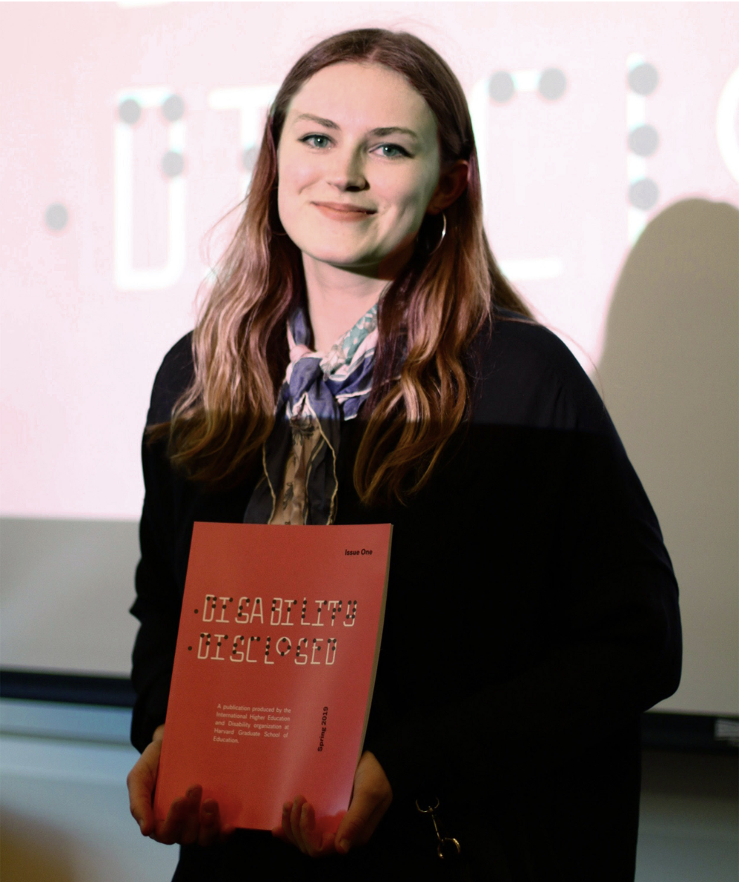
Disability is incredibly diverse. I’m not sure how to accurately explain the many different disability issues experienced by students from different Schools (at Harvard).
Nikita, student co-founder of Disability Disclosed
Notes:
AMY This is Nikita Anderrson, a graduate student. She is the co-founder of the journal Disability Disclosed and leader of efforts to make disability support more streamlined at Harvard. She writes that QUOTE. The journal is available online with writings from Nikita and other students at Harvard. As Kerry & Gabe discuss the tools and practices to make peer learning more accessible keep this point in mind as a reminder of the differences, both evident and unseen that may exist in class participants.

Slide 15
Accessible Peer Learning
Shifting the focus from addressing the needs of a single student to creating a learning environment that works for all learners.

Slide 16
General Practices
General practices to make your teaching style more accessible
Notes:
Before we dive into specific examples, I want to share some practices that you can implement into your general teaching methodology to make it more accessible

Slide 17
Make it safe and easy for students to request accommodations
Share your goals for accessibility with all of your students
Give your students a safe and easy way to share their needs
Notes:
Be open with students about your goals for designing an accessible class. Ask them to speak up if they have suggestions for how to make the course materials and activities more accessible throughout the course. Anonymous feedback surveys throughout the course can help students feel comfortable giving constructive feedback.
Give the students an opportunity to disclose any accommodation needs in a safe and easy way. Some instructors use anonymous surveys at the start of the semester to help students feel safer asking for what they need.

Slide 18
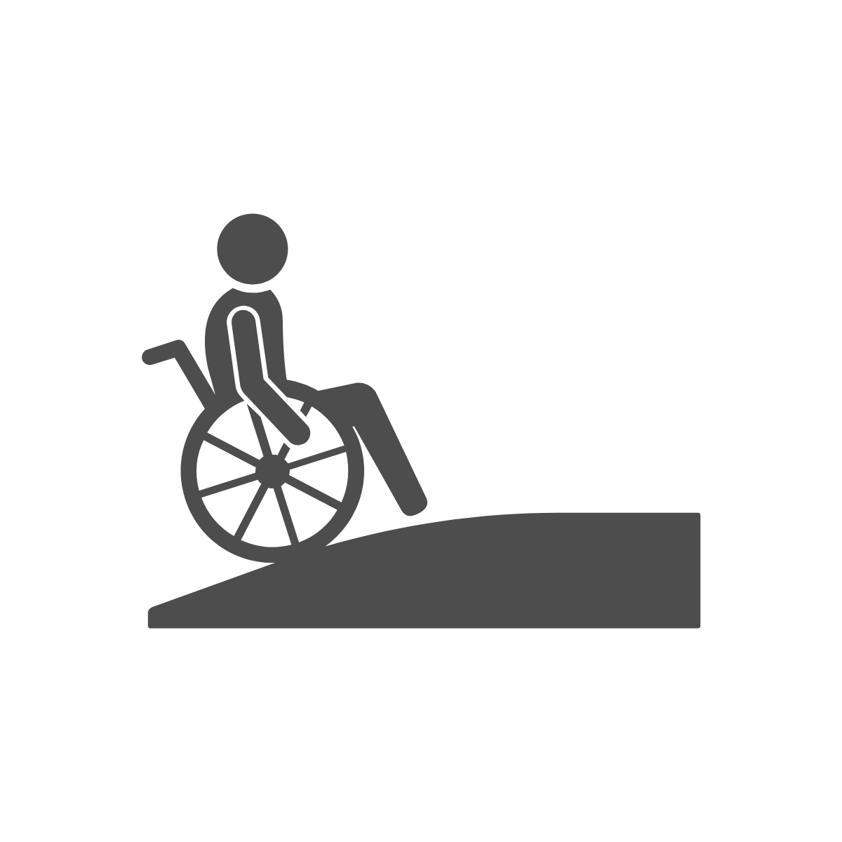
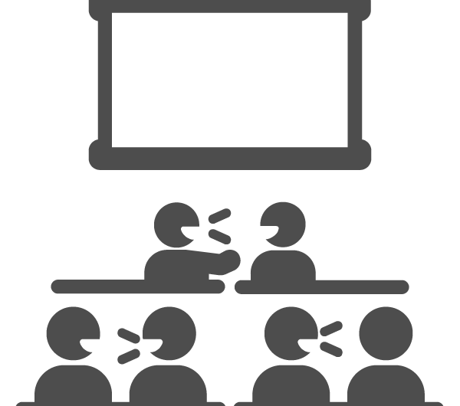
2. Be mindful of the space you’re in
Ensure your classroom is set up to allow all students to participate
Arrange a quiet space for those that may need it
Notes:
One of the great things about Harvard’s campus is that it has so much history. Many of the buildings here are old! You may be teaching in a building that isn’t ideal from an physical accessibility perspective. If you’re going to ask students to move around for any of the activities, be mindful of what your students need.
Remember when we said not all disabilities are easy to see? Be mindful that people with hearing and cognitive impairments may need a quiet place to go to complete the activity you’ve planned.

Slide 19
3. Use two forms of communication
Vocalize anything you write on the board during class
Describe images on slides & narrate when screen sharing
Turn on your webcam when teaching online
Notes:
If you write something on the board, make sure you say out loud what you’re sharing with the class.
Be sure to describe images on slides. Narrate when screen sharing.
Webcams are important if you’re in a synchronous online session to that students can read your lips. Protip: It’s also great for improving connection with your students and peers.

Slide 20
4. Make physical materials accessible
Create accessible digital versions of any handouts or class materials
Utilize large text and high contrast images on handouts
Notes:
Create accessible digital versions of any handouts or class materials (Gabe will speak more about how to do this shortly)
Utilize large scale text. A good rule of thumb for handouts is, if you have space on the page, use it. WCAG 2.1 describes large text as at least 18 point or 14 point bold or font size that would yield equivalent size for Chinese, Japanese and Korean (CJK) fonts. For more information, please visit https://www.w3.org/TR/WCAG21/#dfn-large-scale

Slide 21
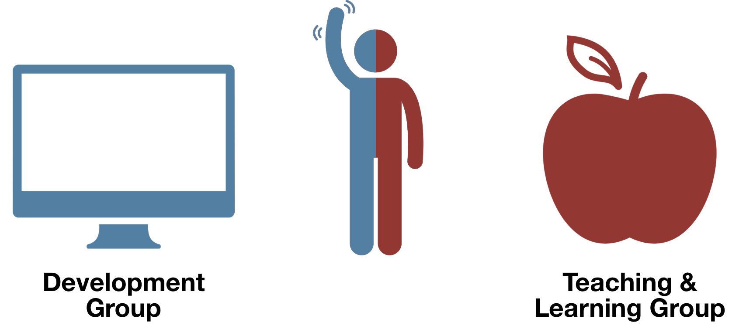
Notes:
Gabe:
Just to finish introducing myself...

Slide 22
Why Tools are in the Mix:
Assistive tech works better with tools than paper
Online classes & groups at distance use tools anyway
Notes:
Gabe

Slide 23
3 Ways to Make your Tools Accessible
1. Choose
Accessible Tools
2. Build
Accessible Tools
3. Adopt
Accessible Practices
Notes:
Gabe:
LEMME START BY BREAKING MY GENERAL TIPS INTO 3 Categories:
Here are 3 ways to...

Slide 24
Choose Accessible Tools
Harvard Licensed Tools
Canvas
Features
Notes:
Gabe
Example: Zoom for video conferencing
Canvas is substantially conformant with WCAG (“wicag”) 2.1 standards: level A and level AA

Slide 25
2. Build Accessible Tools
Use UI Kits
instructure-ui
bootstrap
Use Conventions
usual names (“submit”, etc.)
headers, tab-indexing
nav in usual place
No Glitter
flash < 3x per sec
fewer animations
allow media control
Notes:
Gabe
Don’t reinvent the wheel
“Submit” good – “Go” bad ALSO tab-indexing for people navigating with keyboard + people with screen readers
Media control: stop or mute
Applies to all content: pages, canvas site, assignment descriptions, etc.

Slide 26
3. Adopt Accessible Practices
Simplify
use plain language
break up content: bullets & headers
Be Descriptive
describe buttons/links
add alt text
Hi-Contrast
accessible palette
colorsafe.co
Notes:
Gabe:
✓
Instead of “click here” as link title, call it “download syllabus” ALSO alt-text only for images that add value, not decorative. Example: icons on this page. Adding descriptions to everything increases cognitive overload, just another thing to listen to that doesn’t give valuable information
WCAG 2 level AA requires a high contrast ratio*
*WCAG 2 level AA requires a contrast ratio of at least 4.5:1 for normal text and 3:1 for large text, and a contrast ratio of at least 3:1 for graphics and user interface components (such as form input borders). Level AAA requires a contrast ratio of at least 7:1 for normal text and 4.5:1 for large text.

Slide 27
Summary (on the handout)
Choose Accessible Tools
1
Use Canvas or tools officially licensed by Harvard.
See accessibility.huit.harvard.edu/resources
Build Accessible Tools
2
Use UI Kits (instructure-ui, bootstrap, etc.), Use Conventions (usual names & nav loc), Limit Flashing or Animated Elements. See accessibility.huit.harvard.edu/developers
Adopt Accessible Practices
3
Use simple wording, use descriptive names for links or buttons, use a high-contrast color palette. See accessibility.huit.harvard.edu/content-creators
Notes:
Gabe:
Mention the handout
Don’t re-read

Slide 28
Practices & Tools Applied to Examples

Slide 29
Turn to Your Neighbor
Think, pair, share. In person or online.

Slide 30
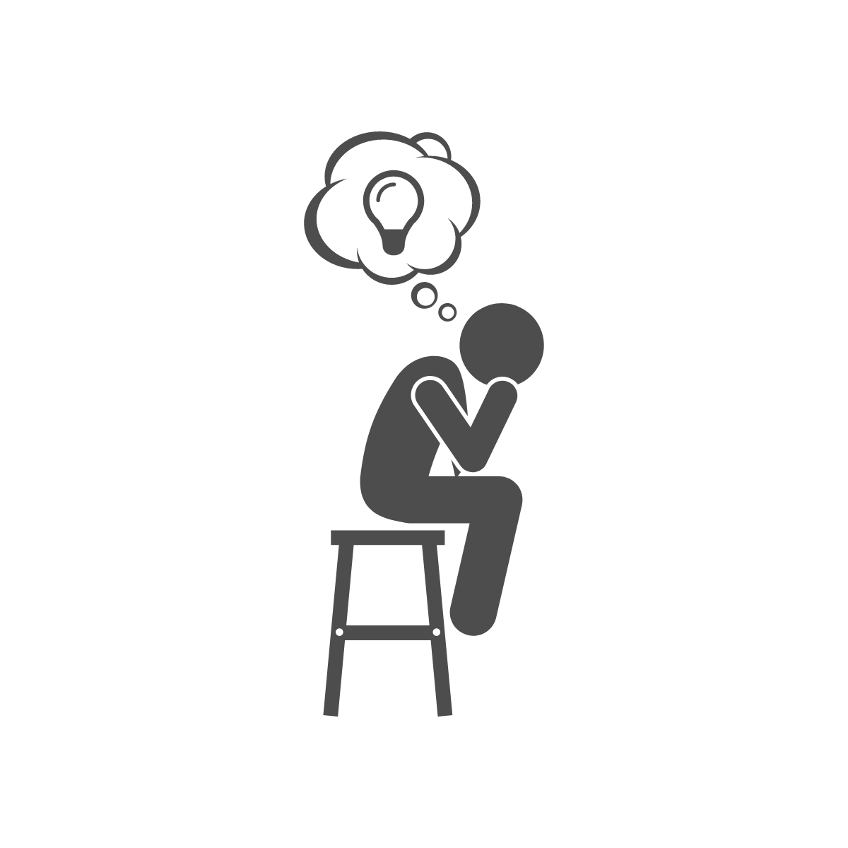
Think
Share an accessible digital version of the activity before class
Give students enough time to work through the problem on their own
Encourage students to write down their thoughts & ideas
Notes:
Sharing an accessible digital version before class can be incredibly useful for many students. This will give them more time to look over the prompt and it will reduce any stress that downloading the prompt during class might cause.
Don’t underestimate the importance of the “think” step of the activity.
Some students will need to write down their thoughts and ideas, and it’s generally thought that note taking by hand improves retention, so it’s helpful to encourage all students to do this

Slide 31
2. Pair
If doing an analog activity, pair someone with a disability with another student
Arrange a quiet space for those that may need it
Encourage students to use their webcams
Notes:
If you’re aware of a person in the room who has a disability that will make completing an analog activity difficult, make sure they have a partner who is cable of helping them.
As mentioned earlier, arrange a quiet space for students with hearing or cognitive impairments to use if they need to.
Encourage your students to turn their webcams so that their peers can read their lips if they need to.

Slide 32
3. Share
Ask students to describe images & narrate when sharing their work with the class
Notes:
For your class to be accessible, everyone should contribute. Encourage your students to use two forms of communication. Refer back to when you shared your goals at the start of the course as a reminder of the environment you wish to create.

Slide 33
Tools!

Slide 34
MS Word for Accessible Handouts
Use Outline Mode
Don’t just bold your headings
Notes:
Gabe:
Start in outline mode: forces you to create headers and sections. Either way, you should add headers.
Example: syllabus - list of readings might be hard to find if it’s not in a header.

Slide 35
MS Word for Accessible Handouts
Word Accessibility Checker
bit.ly/ms-a11y-checker
Save as PDF Don’t print to PDF
bit.ly/ms-a11y-export
Notes:
Gabe:
Easy tool, walks you through
Visit these links: the buttons are in different places depending on your OS or version of word

Slide 36
Go Farther in Zoom
Ask Students to Turn on Their Cam
So peers can lip read
Assign a Closed Captioner
bit.ly/zoom-cc
Notes:
Gabe:
People with hearing disabilities lip read
In Zoom, assign a closed captioner

Slide 37
In the Works:
Assign people to tables they can access
No handwritten attendance
ImHere Attendance (Previously SwipeIn)
Notes:
Gabe:
Upon swiping their Harvard ID, student is randomly assigned to a group
For: turn to your neighbor, flipped classroom groups, etc.
You can pre-assign students to tables they can access (MENTION THIS ROOM’S LAYOUT)
Avoids need for handwritten attendance

Slide 38
Summary (on the handout)
Use MS Word Accessibility Features
4
Turn on outline mode, use the accessibility checker. See bit.ly/ms-a11y-checker
Save as PDF, don’t print to PDF. See bit.ly/ms-a11y-export
Teach Accessible Zoom Norms
5
Tell students to turn on their cameras (so peers can lip read) and assign a closed captioner. See bit.ly/zoom-cc
Notes:
Don’t re-read.

Slide 39
Semester-long Group Projects
Foster collaboration and community in your course in a way that’s accessible for everyone.
Notes:
Group projects can be challenging in person, but especially online. Our ideas about accessibility double as general best practices for making long-term group projects work better.

Slide 40
Facilitate Group Formation Online
Create a Thread on your Discussion Board
Use Canvas Self-assign Groups
Name them by time or interest
Notes:
Organic group formation in person (in busy, cluttered, loud rooms) are tough environment for some with disabilities. Just going online is a big help!

Slide 41
Begin the project with a group charter
Ask students to be explicit about what tools they want to use for collaboration
Set expectations for face-to-face meetings
Use webcams, two forms of communication, Zoom captioning
Notes:
Some students may not have access to certain options, or the usual tools might not have the accessibility features needed. A good example of this is that students in China do not have access to google. If you intend to collaborate using google docs, this will be especially hard for them.
Ask your students to explicitly set norms for face-to-face meetings in their charter. This will give students an opportunity to ask for what they need without having to bring it up on their own.

Slide 42
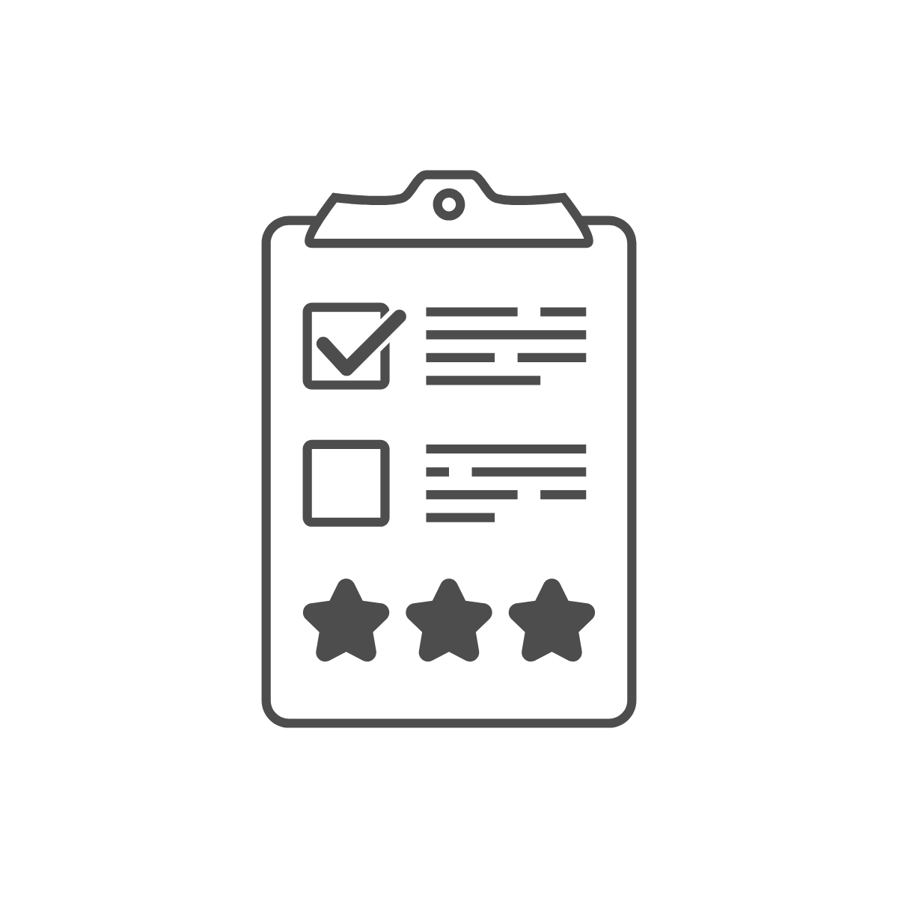
Provide accessible assignment details
Ensure the assignment prompts are clear and detailed.
Use rubrics when possible.
Share an accessible digital version of the assignment prompt.
Notes:
Reduce confusion and cognitive load by ensuring your assignment prompts are clear and detailed. Rubrics are a fantastic way to help students understand what you are expecting from them.
As mentioned previously, always share an accessible digital version of the assignment prompt.

Slide 43
Tools!
Notes:
KYLE

Slide 44
Encourage Accessible Collaboration
Collaborate in Online Spaces
Use headers & outlines in g.harvard.edu
Let Groups Choose Communication Tool
Canvas Group, Slack, Zoom, as long as whole team agrees
Notes:
Gabe:
Online allows use of assistive technology during collaboration
Different platforms have different pros/cons. Let teams decide where they will communicate. Canvas group is a good first bet, but let them choose if something else is better for them.

Slide 45
Make Deliverables Accessible
Always Allow Digital Submissions
Set up submissions in Canvas
Consider Media Alternatives
Auto-captioning isn’t reliable. Consider transcripts + written description of what’s happening
Notes:
Gabe:
For traditionally non-digital submissions, think of a way to make a digital submission option. Use Canvas!
For students submitting media-based submissions (create a video, for example), ask them to write a transcript or written description of what’s happening...this is a great planning step anyway!

Slide 46
Summary (on the handout)
Facilitate Group Formation Online
6
Create a group formation thread on your discussion board or use Canvas self-assign groups (name groups by interest of time so students can find compatible peers)
Encourage Accessible Collaboration
7
Ask students to collaborate in Google Docs (g.harvard.edu is best) or other online spaces and let groups choose their communication tool (Canvas Group is good baseline)
Make Deliverables Accessible
8
Allow digital submissions for all assignments (set up submissions in Canvas). For media submissions, ask students to write a transcript and description of visuals.
Notes:
AMY

Slide 47
Activity

Slide 48
Turn to Your Neighbor
Slides, Handout, Activity: bit.ly/hilt-a11y-resources

Slide 49
Think (on your own)
Think about a peer learning activity that you’ve done or would like to do as a student or teacher.
How might you incorporate the ideas shared today to make your activity more accessible? Is there anything you can do to make it accessible that we didn’t discuss as a group already?
What questions do you have about how to make this activity more accessible? Where do you get stuck?

Slide 50
2. Pair (with your neighbor)
Turn to your neighbor or someone nearby and share your ideas and questions. Try to help each other think through your activities and get each other unstuck.

Slide 51
3. Share (with the whole group)
Share your thoughts, ideas, and questions with the group.

Slide 52
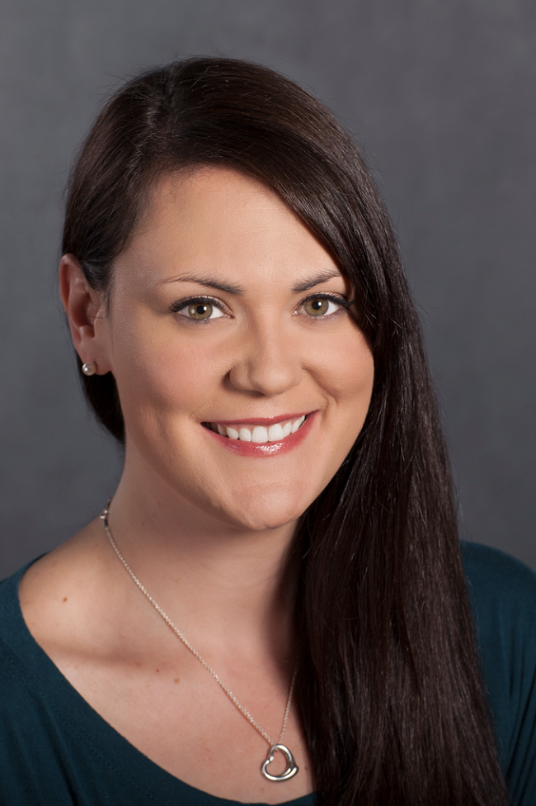
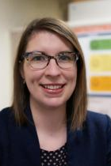
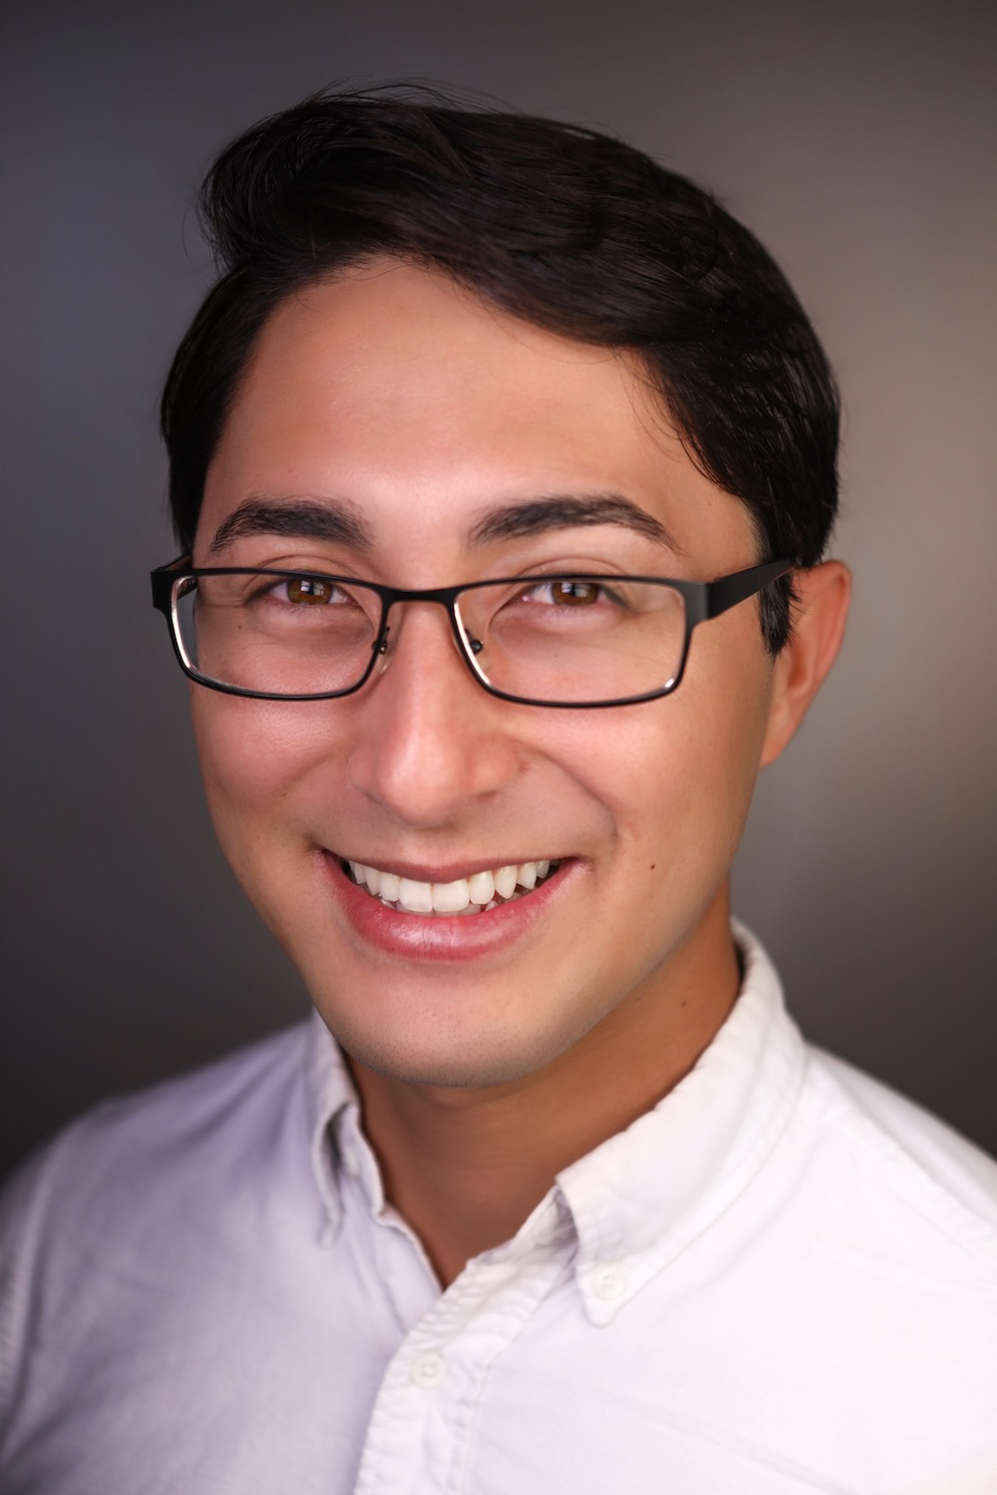
Thank you for coming!
Slides, Handout, Activity: bit.ly/hilt-a11y-resources
Kerry Foley
kerry_foley@harvard.edu
Amy Deschenes
amy_deschenes@harvard.edu
Gabe Abrams
gabe_abrams@harvard.edu

