Slide 2
Peer Learning in
Online Environments

Slide 3
Our Speakers
Bharat Anand, Vice Provost for Advances in Learning (VPAL); Henry R. Byers Professor of Business Administration; Senior Associate Dean, HBS Online (HBS)
Mary Godfrey, Production Manager (HarvardX) and GSE student
Daniel Spratt, Instructor, (DCE); Professor of Medicine at Maine Medical Center and Tufts School of Medicine
Kristin Sullivan, Senior Director of Educational Technology and Director of Public Leadership Credential (HKS)
Teddy Svoronos, Lecturer in Public Policy (HKS)

Slide 4
Session Flow
Introduction (5 minutes)
Speakers (10 minutes each)
Peer activity (10 minutes)
Q&A (5 minutes)

Slide 5
A Brief History of Time
1800s: First correspondence courses, with materials delivered via parcel post
1919: First licensed radio station dedicated to educational broadcasting
1930s: Television for educational purposes
1982: Computer conferencing enabled distance education
1989: Online learning through the internet (via browser came in 1993)
1998: First fully online programs
1999: Students used the computers in my classroom to take courses online

Slide 6
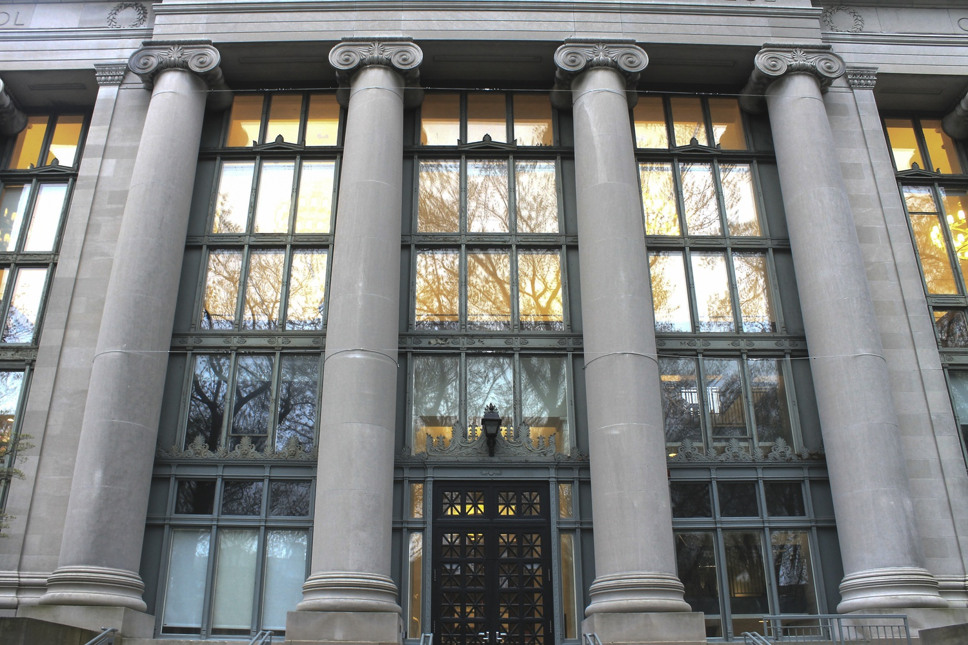

Slide 7
Guiding Questions
What aspects of online learning can make peer engagement particularly effective?
What aspects of peer engagement can make online learning particularly effective?
What tools and approaches can help leverage the benefits of peer learning online?

Slide 8
Bharat Anand (HBS)

Slide 9
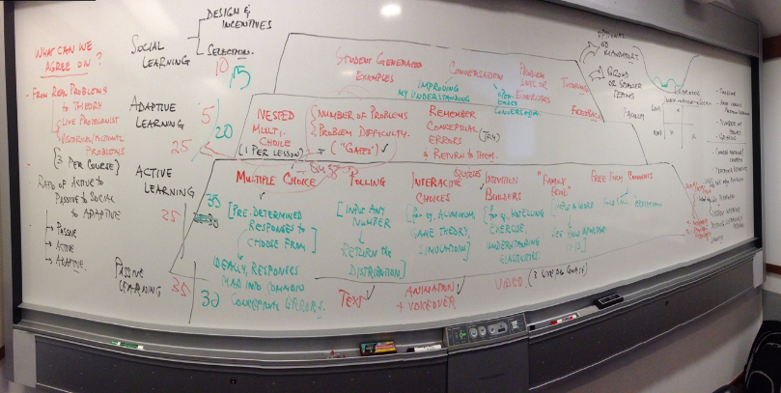
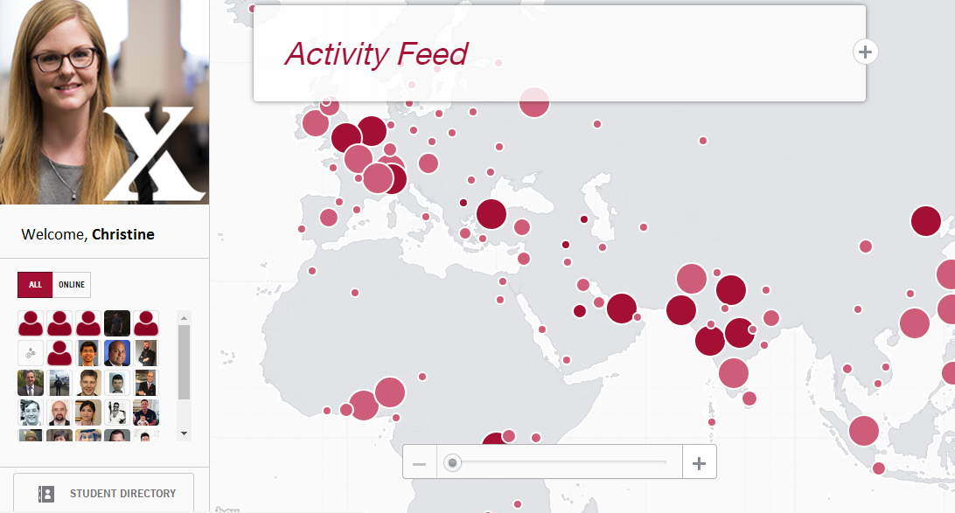
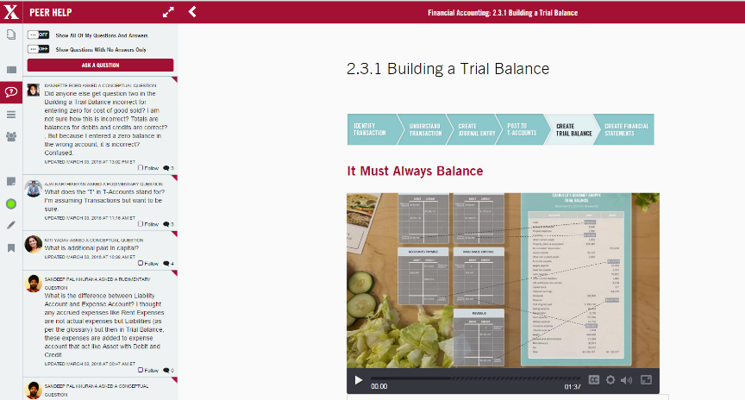
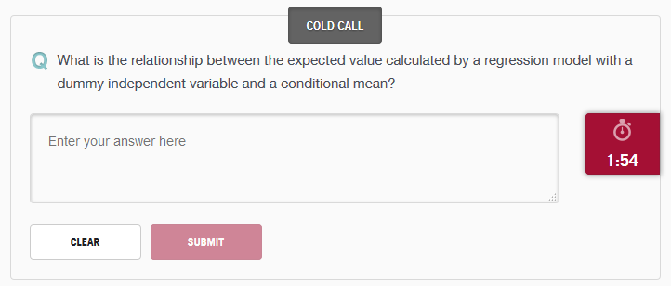
HBSO: Peer Learning (Asynchronous)
Notes:
‹#›

Slide 10
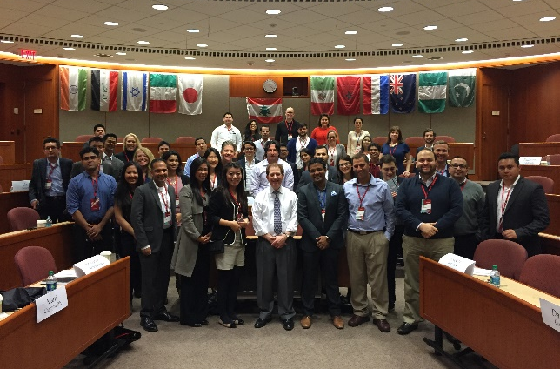
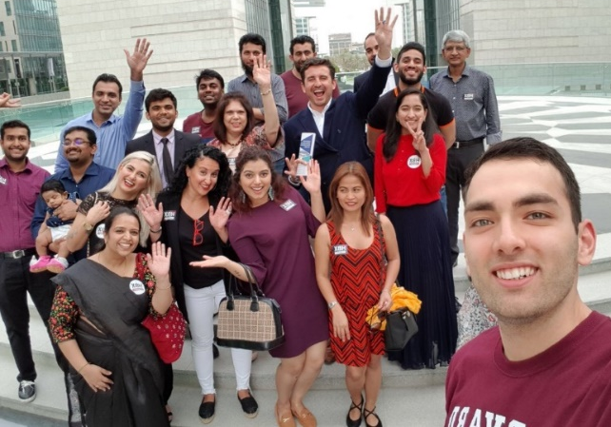
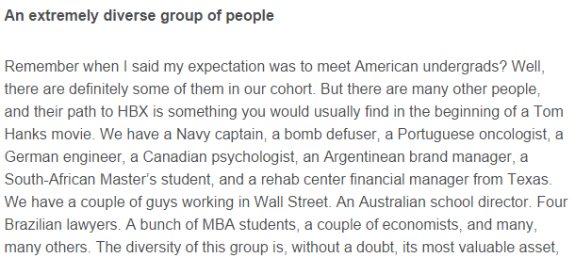
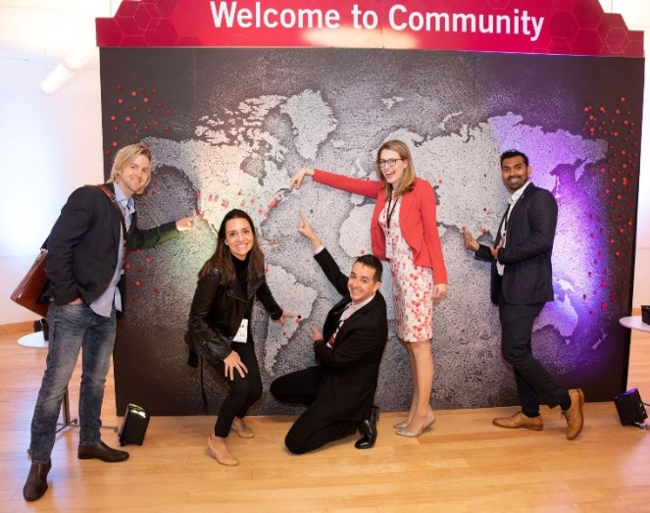
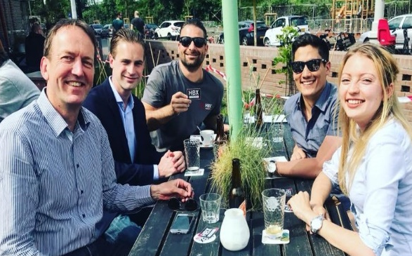
HBSO: Learner Community
500+ attendees
48 countries, 6 continents
6,700+ current members
29 Chapters
90 events

Slide 11
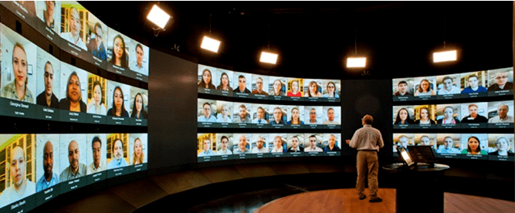
HBSO: Peer Learning (Synchronous)
Notes:
‹#›

Slide 12
Mary Godfrey (GSE student)

Slide 13
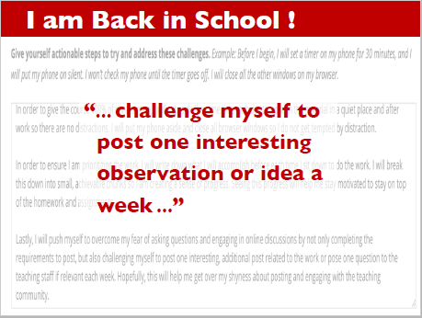

Slide 16
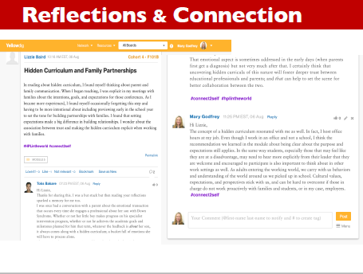

Slide 17
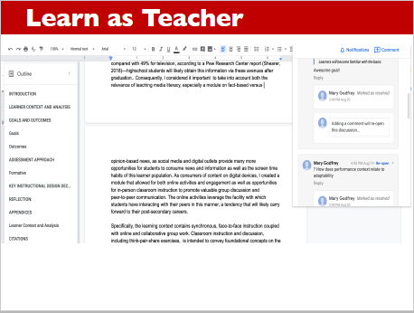

Slide 18
Daniel Spratt (DCE)

Slide 19
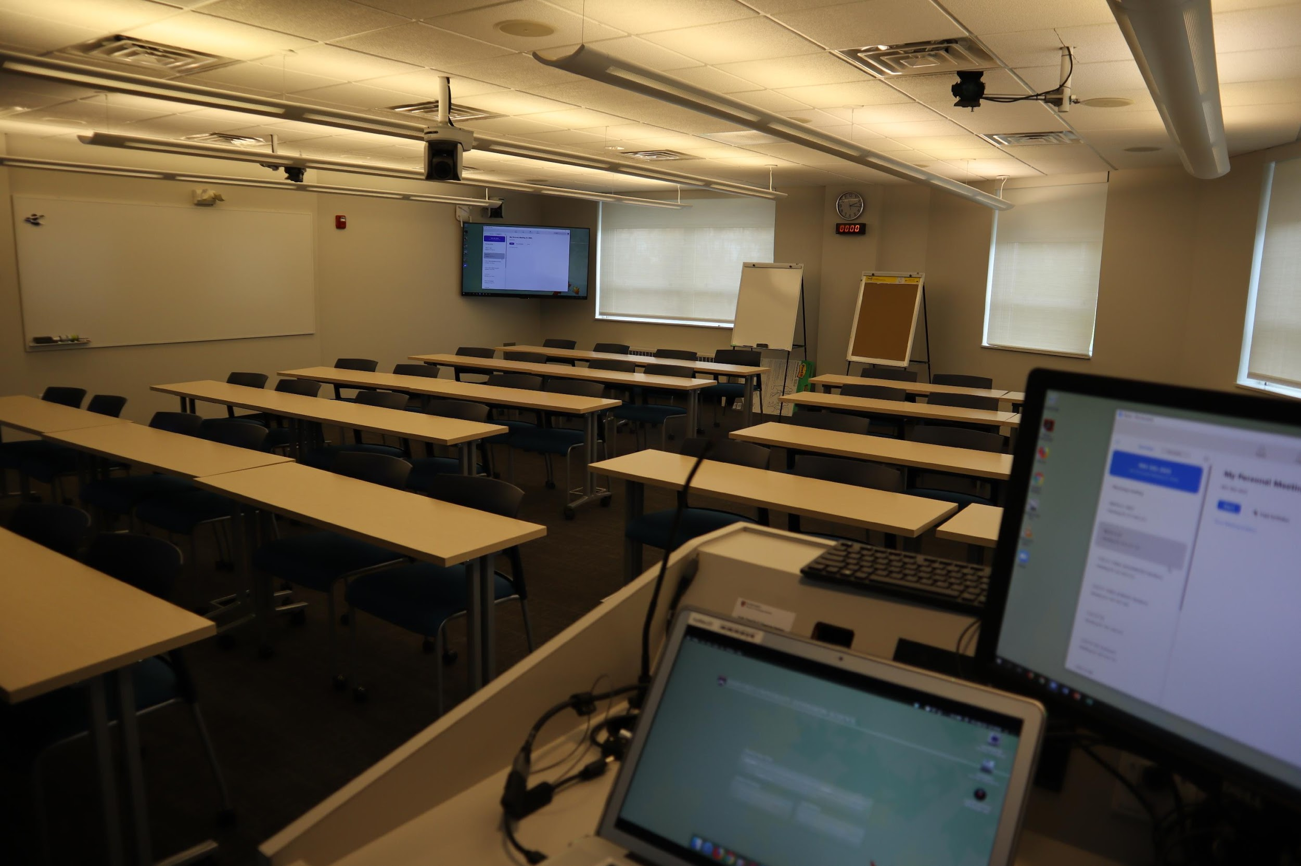
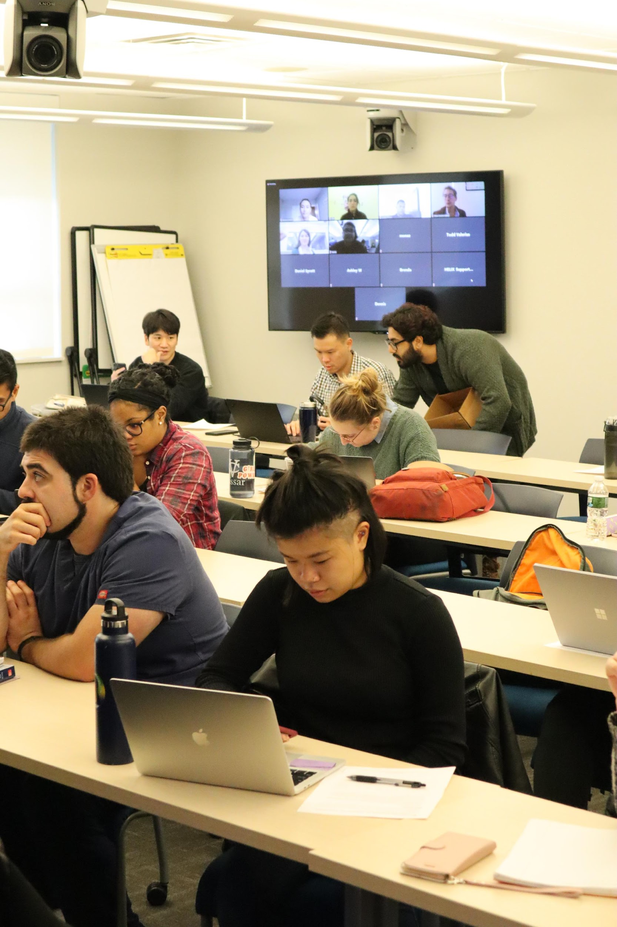
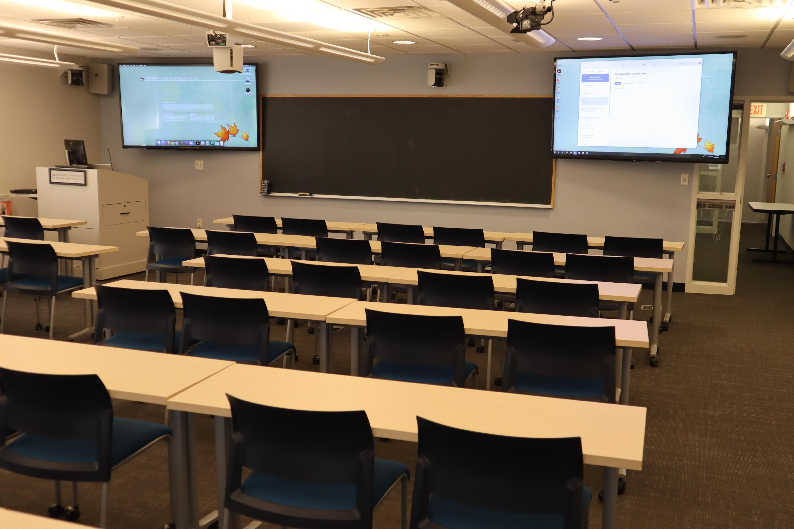
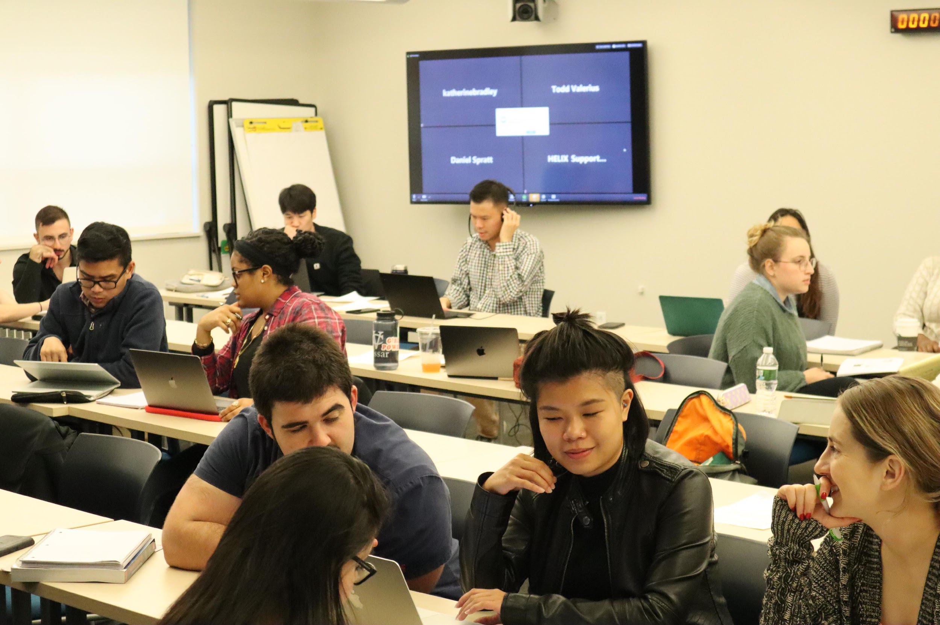

Slide 20
Teddy Svoronos (HKS)

Slide 21
Kristin Sullivan
Director
Dan Levy
Faculty Director
Chris Robichaud
Faculty Lead
Leadership and Ethics
Teddy Svoronos
Faculty Lead
Evidence for Decisions
Michael Walton
Faculty Lead
Policy Design and Delivery
Course Design
Course Delivery
Danielle Feinstein
Research and Content Manager
Maria Flanagan
Associate Director for Digital Learning Design
Alyssa Aughenbaugh
Program Coordinator
Alexis Estrella
Program Operations Manager
Mae Klinger
Senior Digital Learning Designer
Lori Stokes
Digital Learning Designer
Chrissy McKeon
Senior Instructional Technologist
Neil Patch
Online Learning Manager
Tamara Tiska
Digital Course Producer
And our TAs…
Zulfiyya Abdurahimova-Carberry, Anais Alonzo Anderson, Jose Luis Bacigalupo, Suzie Byers, Erika Caballero Montoya, Enrico Calvanese, Monnica Chan, Cassandra Devine, Emma Dwight, Danielle Feinstein, Rachel Goodyer, Ayushi Gummadi, Angelo Kalaw, Homa Koohi, Rifaiyat Mahbub, Vinay Nagaraju, Victor Perez-Garcia, Billy Pope, Pedro Protasio, Preeti Sahai, Costanza Sciubba-Caniglia, Jonathan Sclarsic, Kirtika Singh, Mathangi Swaminathan, Homa Taheri, Ibrahim Worku Hassen

Slide 22
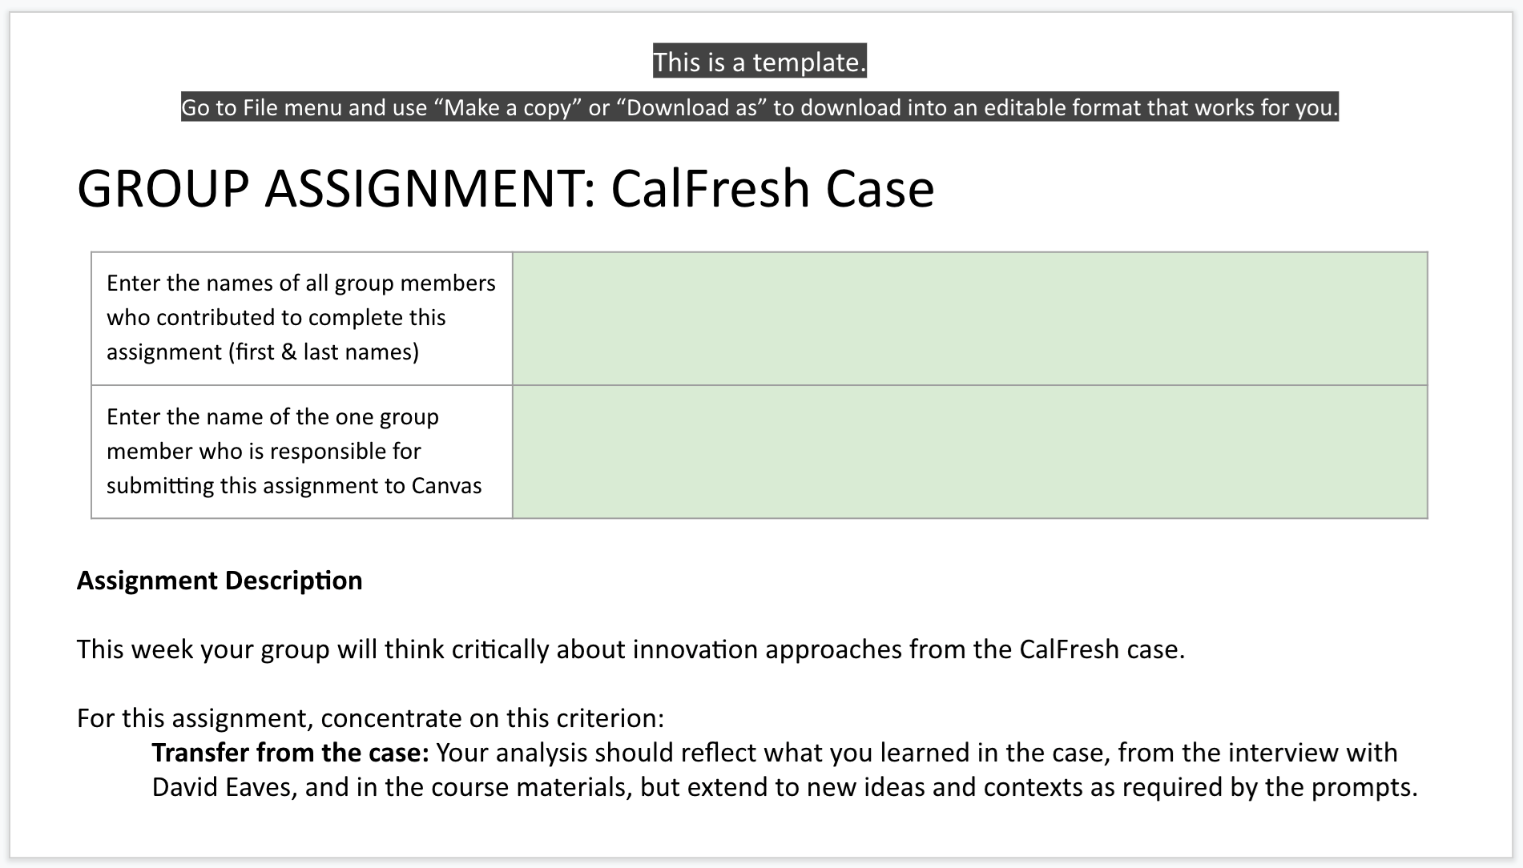

Slide 23
Session Flow
Introduction (5 minutes)
Speakers (10 minutes each)
Peer activity (10 minutes)
Q&A (5 minutes)

Slide 24
Peer Activity
Recall a time when you engaged with someone online, whether in a learning context or a social context.
In what ways did the interaction deepen your thinking (or not)? Reinforce or change a perspective you had?
Did you feel you were part of a community, and if so how did that sense of community impact your engagement / learning?

Slide 25
Questions? Comments?
Thank you!

