Slide 1
Making the Most of Student Evaluations
Bill Wisser, PhD
Teaching and Learning Lab, HGSE
Willis Emmons, PhD & Alexandra Sedlovskaya, PhD
Christensen Center for Teaching and Learning, HBS
HILT Conference: Evaluating Teaching
September 20, 2017

Slide 2
Agenda
Learning from students
Case study
Learning from peers

Slide 3
What’s one thing you would like to learn from your students to improve your instruction?

Slide 4
What’s one thing you would like to learn from your students to improve your instruction?
Think to yourself / Jot down one idea
2 Min

Slide 5
What’s one thing you would like to learn from your students to improve your instruction?
Share with a partner
3 Min

Slide 6
What’s one thing you would like to learn from your students to improve your instruction?
Share out with the group
5 Min

Slide 7
What’s one thing you would like to learn from your students to improve your instruction?
Their purposes, expectations, and goals
How to increase/decrease/measure engagement, how to tell in the moment
Pre-assessment material?

Slide 8
HBS Context
Case method pedagogy
No undergraduates
MBA program
  First year
    Ten sections of 90 students
    Uniform curriculum, common syllabi
  Grading: fixed curve, participation = 50%

Slide 9
SETs at HBS
  Course and Instructor sections
  Quantitative ratings (1-7)
    Quality standards, discussion management, managerial relevance, responsiveness to students, overall effectiveness of the instructor
  Qualitative questions
    2-3 things instructor did well, should continue to do
    2-3 things to focus on for improving effectiveness
  Demographic questions
    Prior understanding of the field (1-7)
    Gender, citizenship (US/nonUS)

Slide 10

Dave Anderson
What’s the story or “theory of the case”?
If you were to advise Professor Anderson on improving his teaching effectiveness, what 2-3 suggestions would you make?
Read & discuss at your table
15 min

Slide 11
Insights & Surprises
Richness of qualitative data
Risk of selective reading, misinterpretation
Rating distributions vs. averages
Value of outlier data
Potential impact of students’ prior knowledge and demographic characteristics
Perceptions become reality

Slide 12
Strategies and Takeaways
Look holistically at student feedback; consider summative evaluations as one data point
Discuss with peers in similar content areas
Hone in on specific questions that are important to you and that undergird your philosophy of learning
Consider longitudinal data from one question as a marker of change

Slide 13
What’s one STRATEGY YOU USE WHEN REVIEWING YOUR EVALUATIONS?
Note: View the next slide in “presentation mode” to read your colleagues’ responses. Scroll down to view all.

Slide 14
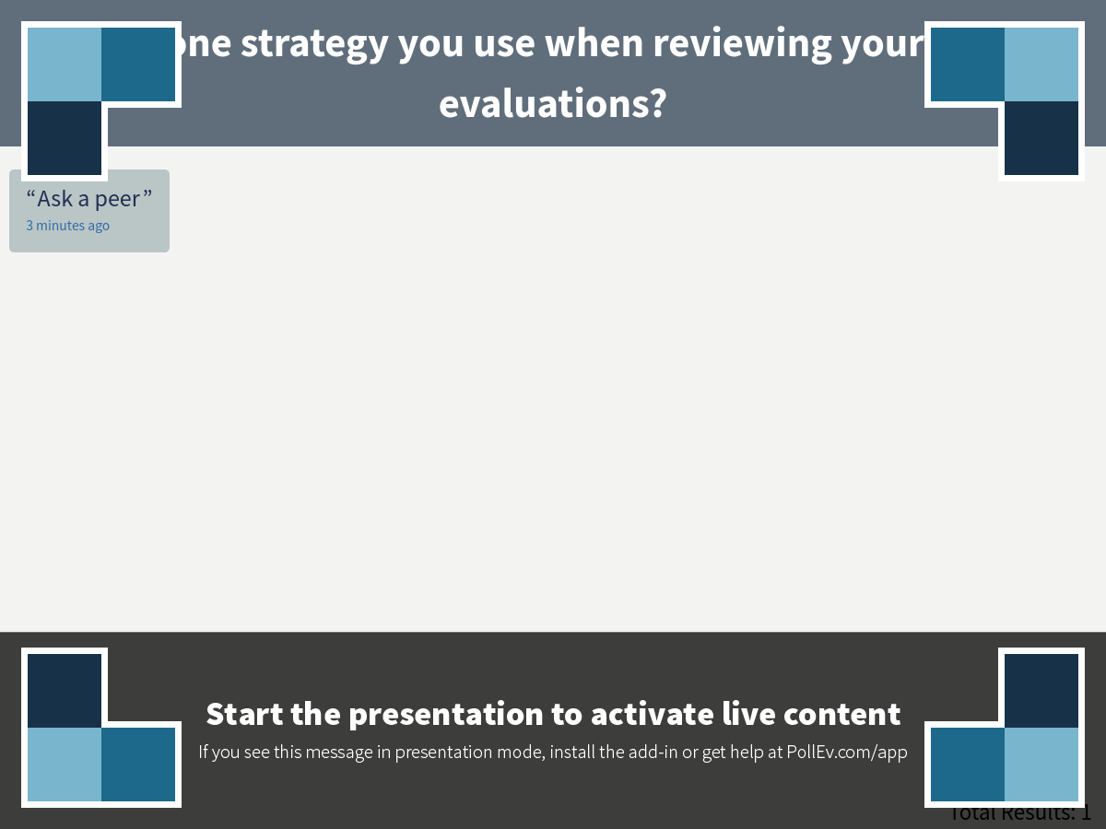
Notes:
What's one strategy you use when reviewing your student evaluations?
https://www.polleverywhere.com/free_text_polls/Q4XcdI00mpBNvRZ

Slide 15
“To communicate our genuine appreciation for the knowledge and judgment of our students, we can invite them to join us in defining the terms of our academic collaboration—and make sure to honor their terms with our practice.”
-C. Roland Christensen

