Slide 1
Teamwork in the flipped classroom
Henrike C. Besche, PhD
Lecturer in Cell Biology
Associate Director of Curriculum Integration
Office of Educational Quality Improvement || Harvard Medical School

Slide 2
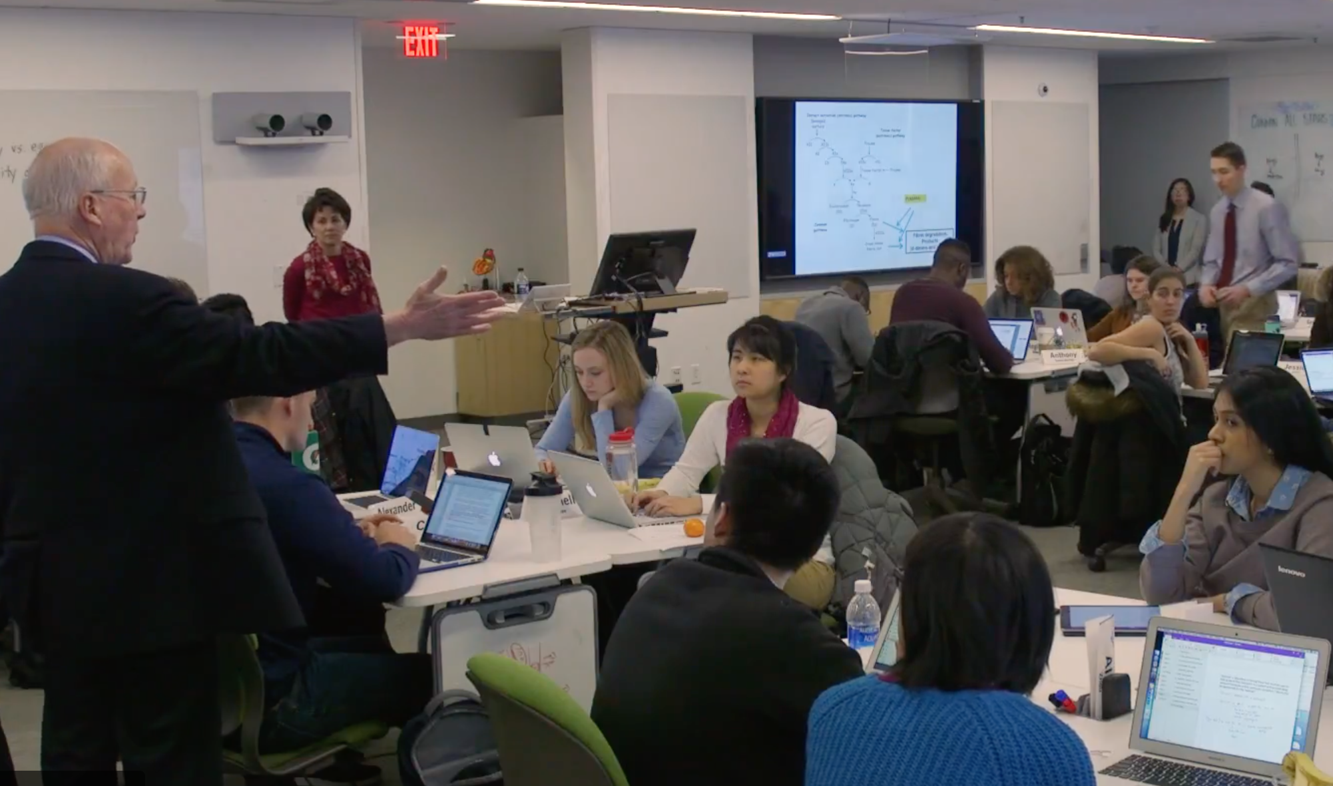
The Pathways Curriculum at HMS
Est 2015
Notes:
On the left Albany Medical School Amphitheater with Medical Students and Patient-Based Demonstration. Albany, 1944. This is how medical education in the pre-clinical curriculum still looks like for most schools around the country and the world. Lectures! Only that these days lectures are recorded and student no longer even attend but watch the videos at home. At HMS for the last 30 years we had a lecture based curriculum paired with small group tutorials. The small groups sound nice in theory, but it was very hard to find enough faculty to consistently guide these groups, and the experience of learning in these small group tutorials varied a lot across students. In 2015 we decided to change all this and rolled out a new year-long pre clinical curriculum without lectures, where students come to class to discuss with faculty and peers.
Images from:
http://digitalcollections.archives.nysed.gov/index.php/Detail/Object/Show/object_id/10222
https://meded.hms.harvard.edu/teaching-tools (From video on peer coaching)

Slide 3
Case-based collaborative learning (CBCL)
Flipped
Case-based
Collaborative
Discussion-based
Workload
Teamwork
Facilitation
What makes a good question?
TODAY
Notes:
We called this pedagogy case-based collaborative learning (CBCL). It is a flipped classroom, with prep work assigned for each class, case-based in a sense that in class we discuss application problems based on the prep work that allows students to deepen or further stretch their understanding (later in the year indeed this is done via patient cases), collaborative as students work in groups of 44, sitting in tables of 4, and discussion-based because the class moves in an alternating rhythm where we throw the class a question that students first discuss at their tables for a few minutes before we report out and discuss as a whole group.
As you can imagine this was a big change from the lecture/tutorial based curriculum, and we did run into challenges during implementation. For example, the flipped nature of the class required turning lecture content into prep work that students could work on independently at home, and one of the biggest challenges we initially encountered was workload. Case-based teaching requires you to think carefully about what kind of questions makes a good class discussion (while being well aligned with prep) and this turned out not an easy process to decide. Working in teams of 4 at their tables also can lead to challenges, and this is what I will discuss today. Last leading a discussion-based class is very different from lecturing and learning these facilitation skills has been another important change for all our faculty, which most recently led us to create a peer coaching program. I could talk about all of these topics, and please feel free to contact me if any of this sparks your interest, but today I will speak to what we learned about how CBCL teams work.
Instructional design
Peer coaching
Ensuring comparable experiences

Slide 4
The CBCL classroom
44 students
11 tables of 4
1-3 faculty
4 classrooms
Notes:
Classroom snapshot form https://meded.hms.harvard.edu/teaching-tools (From video on peer coaching)
As you can see on this image, in the CBCL classroom we have 40+ students sitting at 11 tables of 4. One faculty member is typically running the session, with one or two additional faculty member in the room as needed. The classroom is a very open space with faculty able to walk the room and multiple screens to project and discuss. The white square is a representation of the the CBCL classroom and the 11 tables in green, each with 4 students. The green color indicates that students are content and deeply engaged in rigorous discourse and critical thinking. At least that how faculty envisions this, however over time we gathered anecdotal evidence that at some of the tables sometimes tension was building and students were not working with each other constructively. Since anecdotal evidence is of limited utility we decided to measure how teams were doing in the CBCL classroom.

Slide 5
Not all teams are created equal
Notes:
Using mixed methods we asked students to fill out a validated team performance scale but also asked them open ended questions on what was working well for their team and what needed improvement. We found that at any given moment about a quarter of the students in the room rated their team experience much lower than other students at their table – in other words the experience at these tables was very asymmetric. Another phenomena was split teams, with the table splitting in pairs and little dialogue in four, often one pair feeling excluded by the other pair and having a more negative perception of the table performance. Occasionally there would be a “toxic table” with all members being unsatisfied with their experience, at times specifically related to microaggressions and unconscious biases.
Green – high or well functioning teams
Orange – asymmetric/split teams or toxic

Slide 6
How CBCL teams work well
Feeling safe
Feeling valued
Emotions
Process
Communication
Value everyone’s opinion
Listen to each other
Know when to hold back
Emphasize reasoning
Push for deeper thinking (respectful discourse)
Positive feedback
Elicit everyone’s opinion
Rotating leadership
Time to first think on your own
Varied methods (brainstorming, drawing things out)

Slide 7
What teams that worked less well would like to improve:
Feeling dismissed
Feeling unsafe
Emotions
Process
Communication
Too much focus on correct answer
Answers blurted out quickly
Lack of discourse/reasoning
Not all opinions are heard
Not listening/interrupting
Person dominates
Side conversations exclude some team members
Lack of process

Slide 8
Society “team-scapes”
Week 4 (NO time for teams to discuss norms and process)
Week 8 (2 x 20 min for teams to discuss norms and process)
INTERVENTION GROUP
Notes:
STRESS THAT THEY ARE NOT! THE SAME TEAMS – LIMITATION OF QI vs RESEARCH
(For purpose of this presentation focusing on dysfunctional teams, but in reality also well functioning teams may benefit from more understanding of the teamwork process as they are prone to group think.)

Slide 9
Next steps for CBCL teams at HMS
Create classroom time for teams to set norms and check in on process across all courses to provide a cohesive curricular experience
Pilot peer feedback to further enhance interpersonal and communication skills and a safe and inclusive learning environment
Provide instructional support for building interpersonal skills around teamwork, emotional intelligence and giving and receiving feedback

Slide 10
Using CQI for Implementing Change
Improvement
Continuous
Quality
?
Active skill building/peer feedback
Collaboration/teamwork as program objective
Active learning, lot’s of collaboration, little framework
Lectures, some groupwork, no formal consideration of teamwork
Notes:
So if you enjoyed what I told you about the teams that’s great, however, it is not that different from what we know of teams in other context and research has already shown. In fact you could ask, why didn’t you anticipate this? However, that is not how change happens. Often in the environment you are working in we find ourselves entrenched in values and hierarchies that might be well past their time but are incredibly hard to change. (Why else do we have such a hard time addressing climate change despite an overwhelming amount of data). The real story is not what works for teams – it is about how to make change happen and go from a lecture based curriculum where faculty talk and students listen to a curriculum where students talk and faculty listen and students take as much pride in their academic accomplishments as in their ability to work with others.

Slide 11
Quality Improvement vs Research
QI
Research
NOT hypothesis driven
“How is this is going?”
“How can we make this better?”
Experimental design within limitation of running courses
Data can be gathered in small increments, does not have to be perfect
Hypothesis-driven
“I propose if we do A, it will result in B”
Research design depends on control group
Experimental design complex and needs a lot of lead time
Very difficult to implement in context of running courses

Slide 12
Thank You!
Office of Educational Quality Improvement
Program of Medical Education at HMS
Rich Schwartzstein, MD
Amy Sullivan, EdD
Barbara Cockrill, MD
John L. Dalrymple, MD
Carolyn Wood
Steve Pelletier, PhD
Edward M. Hundert, MD
Randall King, MD PhD

